Slide 1


What’s Cooking….
Your ultimate culinary companion.
-By Group 11

Slide 2


Team members
Akula Niharika
Shreyas M J
Siddhavi Jaywant Raul
Soumyashree Priyadarsinee Nayak
Sumeet Nikesh Bhangale
Trupti Uttamrao Shelar
V S Sunil Naik
Vidhathri C V
Yanamala Sirisha
Group 11

Slide 3
INTRODUCTION
A recipe is a set of instructions that describes how to prepare or make something.​
A recipe is to have a precise record of the ingredients used, how much amount of ingredients are needed and the way they are combined.

Slide 4
ABSTRACT
The main objective of this web application is to create a dynamic and responsive Java application to allow a user to the application and search for recipes online.
This application helps genuine food lovers to explore and have wonderful experience with the recipes uploaded.

Slide 5
CONTENTS
1. Modules
2. Technology Used
3. ADMIN - Flow chart
4. USER - Flow chart
5. Description of our project
6. Use case diagram
7. Advantages
8. Output

Slide 6
01. MODULES
Admin
Login
Create Admin page
Create/delete recipe
Edit/update recipe
Enable/disable recipe
User
Register/Sign into application
Change/update password
Search and see the selected recipe
Filter
Like and comment

Slide 7




02. TECHNOLOGIES USED
Frontend: Angular
Backend: MySQL, Hibernate
Server side: Spring Boot
Testing: POSTMAN

Slide 8
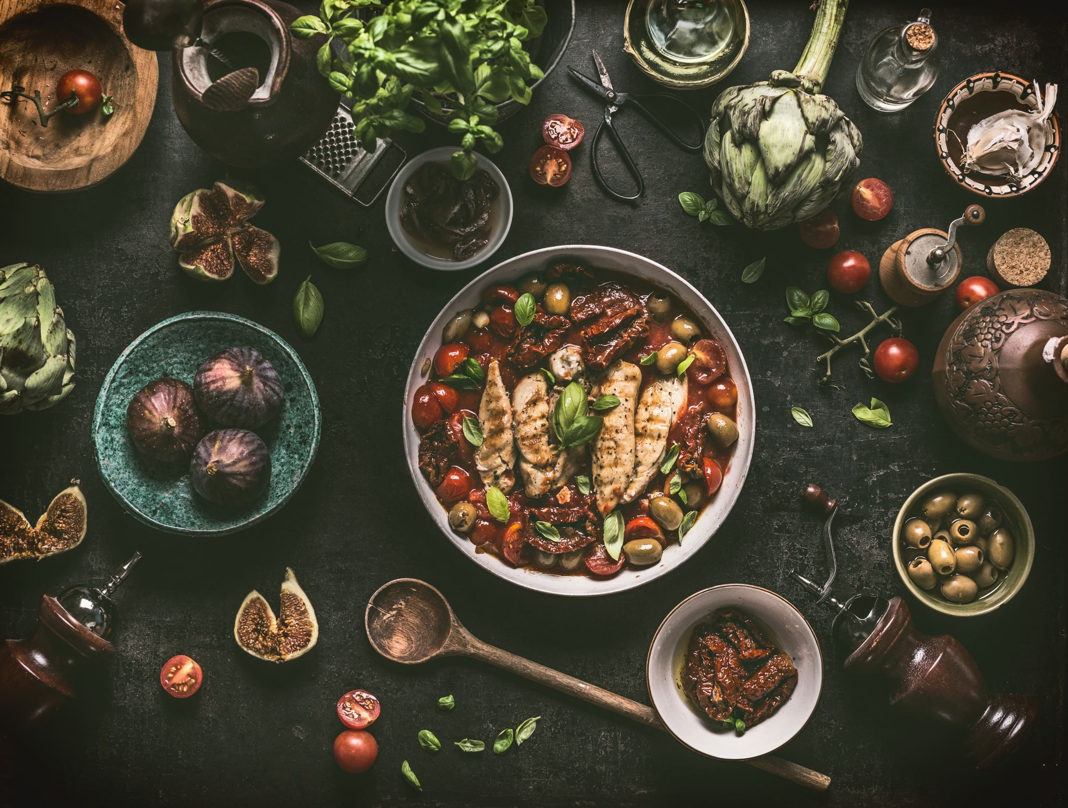
03. ADMIN
Admin will be able to :
Login to the portal
Admin can add / remove
Edit recipe details like name, item details, ingredients and cooking steps

Slide 9
03. ADMIN-FLOW CHART
View all recipes
Admin
Login
Edit recipe
Add recipes
Remove recipe
Logout

Slide 10
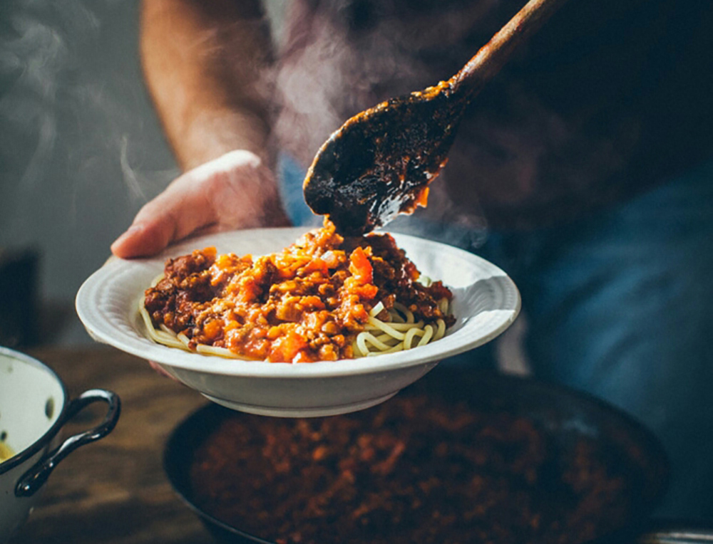
04. USER
User will be able to :
Register to the application
Sign in to the application
Search for recipes based on the search keyword
Can see selected recipe details
Can also like and comment on the item recipe

Slide 11
04. USER - FLOW CHART
Search keyword
User
Login
View all recipe
Search recipe
Register
Like
If New User
Logout

Slide 12
05. DESCRIPTION
REGISTER * A user needs to register in order to access the application. * The user needs to enter his/her username, password, phone number . Those information will be stored in the database and will serve as the profile info. LOGIN * Any application operation requires the user to be registered. * Login is the first step before performing an action.
EDIT * The admin will be able to add/remove. * He will also be able to edit the name, item details and keep it always updated

Slide 13
05. DESCRIPTION
VIEW INGREDIENTS * The admin and registered user of the application shall be able to view ingredients of a certain recipe. VIEW RECIPES * The admin and registered user shall be able to see all the recipes that is present in the application.
SEARCH RECIPES *Any registered user shall able to search for a recipe using the
search bar provided. * The search functionality will provide the users with a shortcut to find their targeted recipes.

Slide 14
6. USE CASE DIAGRAM: Admin
Login
Add/Delete recipes
Admin
Edit recipe
Database
Refresh
Logout

Slide 15
6. USE CASE DIAGRAM: User
Register
View all recipe
Search recipe
Database
User
View selected recipe
Like

Slide 16

7. ADVANTAGES
Search for recipes based on the search keyword like item name, item description.
User will be able to filter recipes based on different categories of the food items.
It ensures the privacy of the users data and secures its access in the database and the maintenance of the application is also easy.

Slide 17
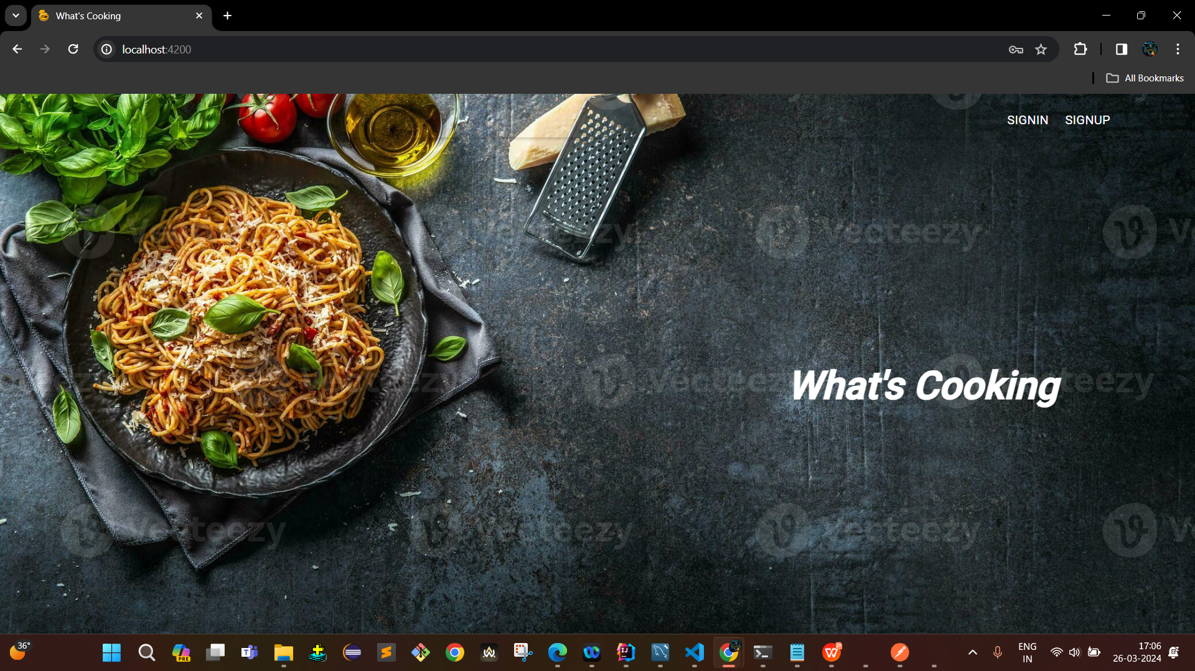

8. OUTPUTS: Welcome page

Slide 18
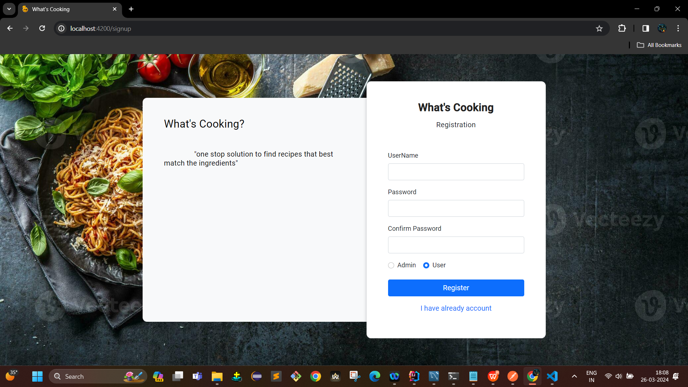
8. OUTPUTS: Admin login page

Slide 19
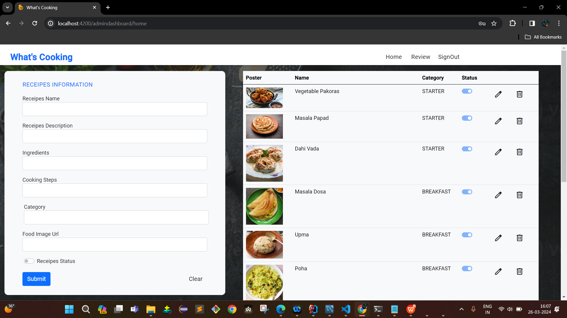
8. OUTPUTS: Admin page: Dashboard

Slide 20
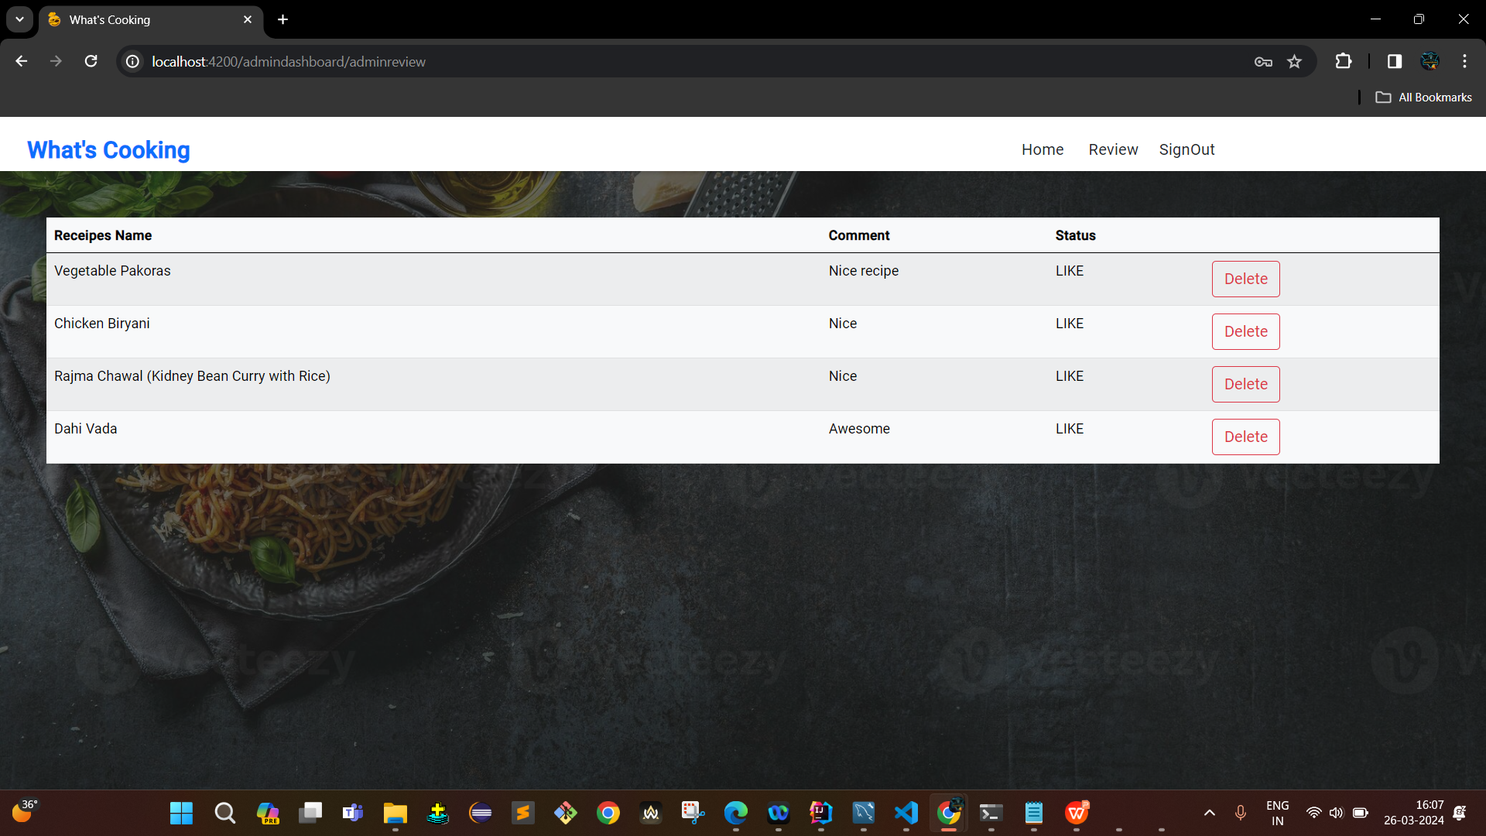
8. OUTPUTS: Admin review page

Slide 21
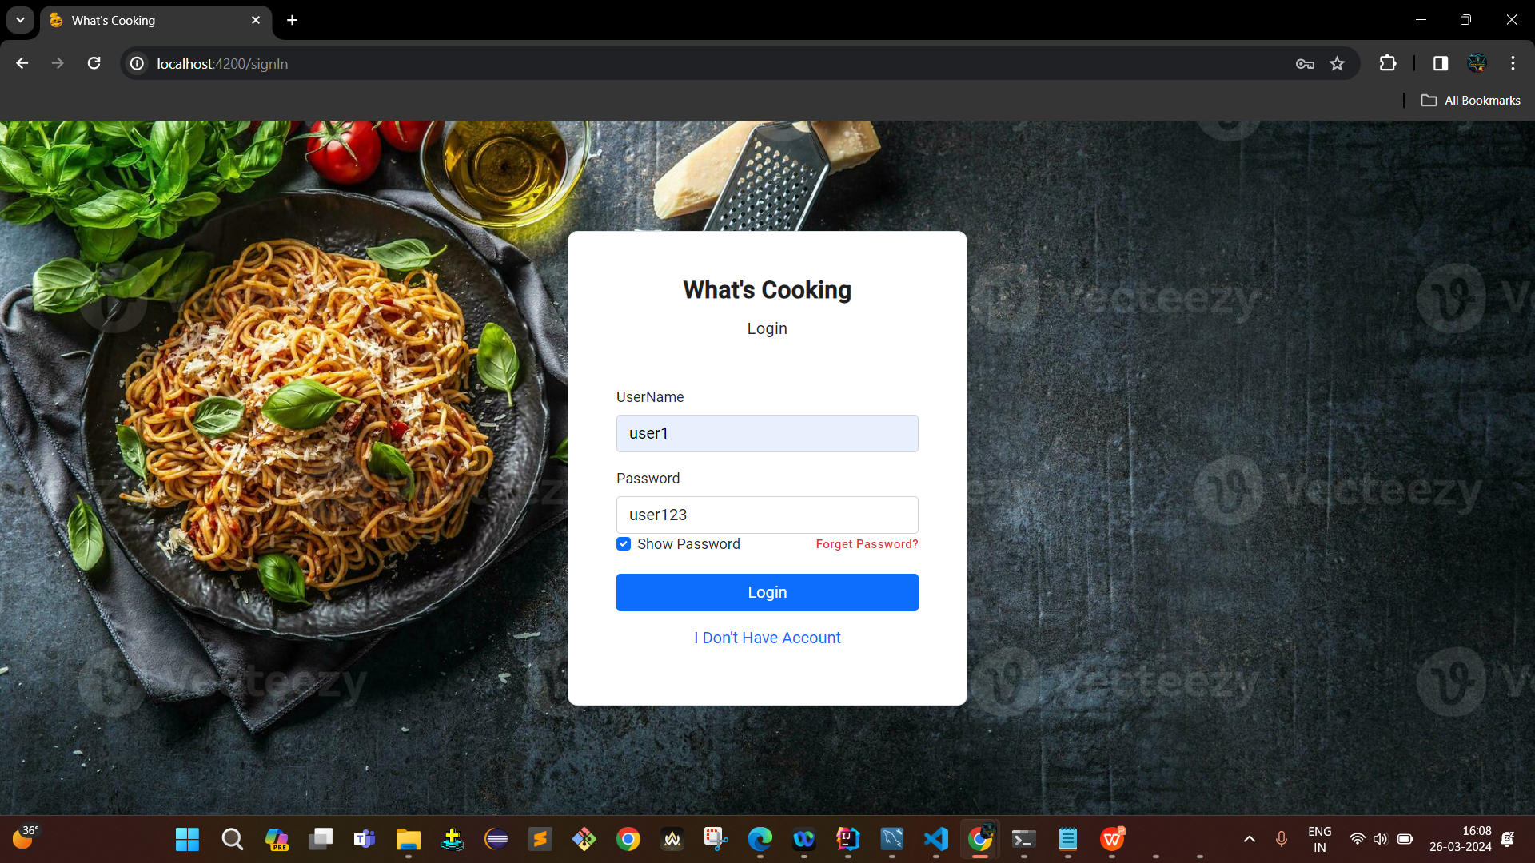
8. OUTPUTS: User login page

Slide 22
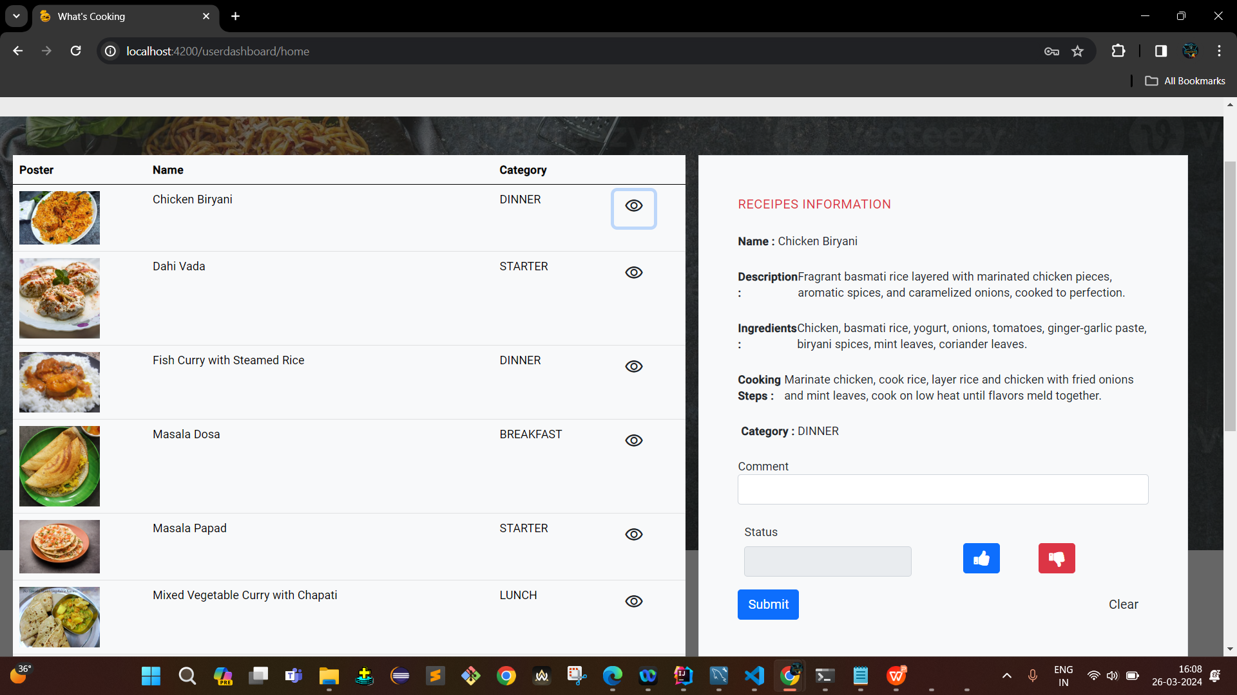
8. OUTPUTS: User page: Dashboard

Slide 23
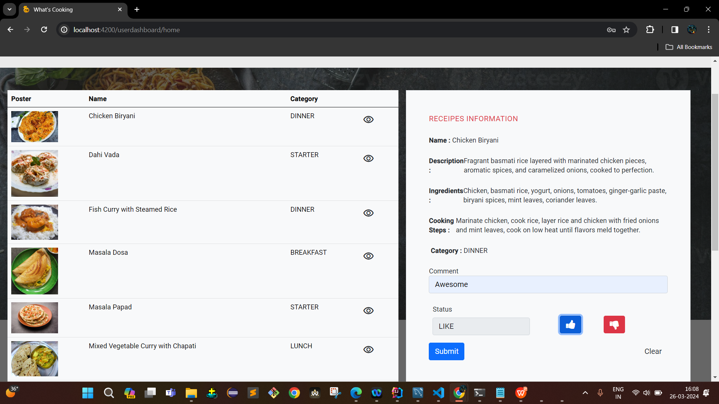
8. OUTPUTS: User page: Dashboard: Like & comment

Slide 24
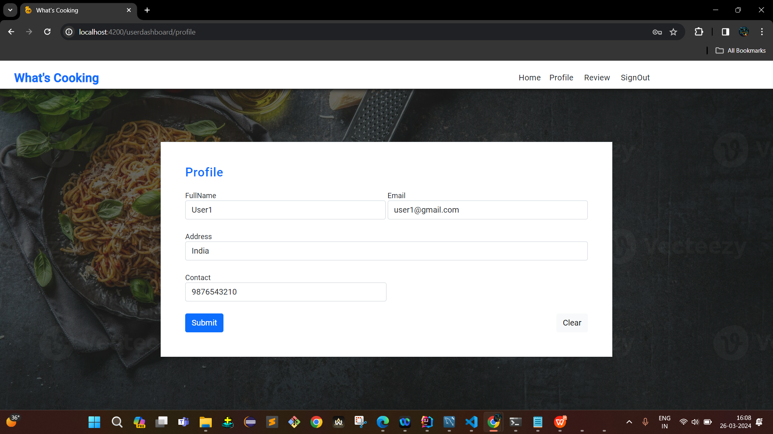
8. OUTPUTS: User page: Update profile

Slide 25
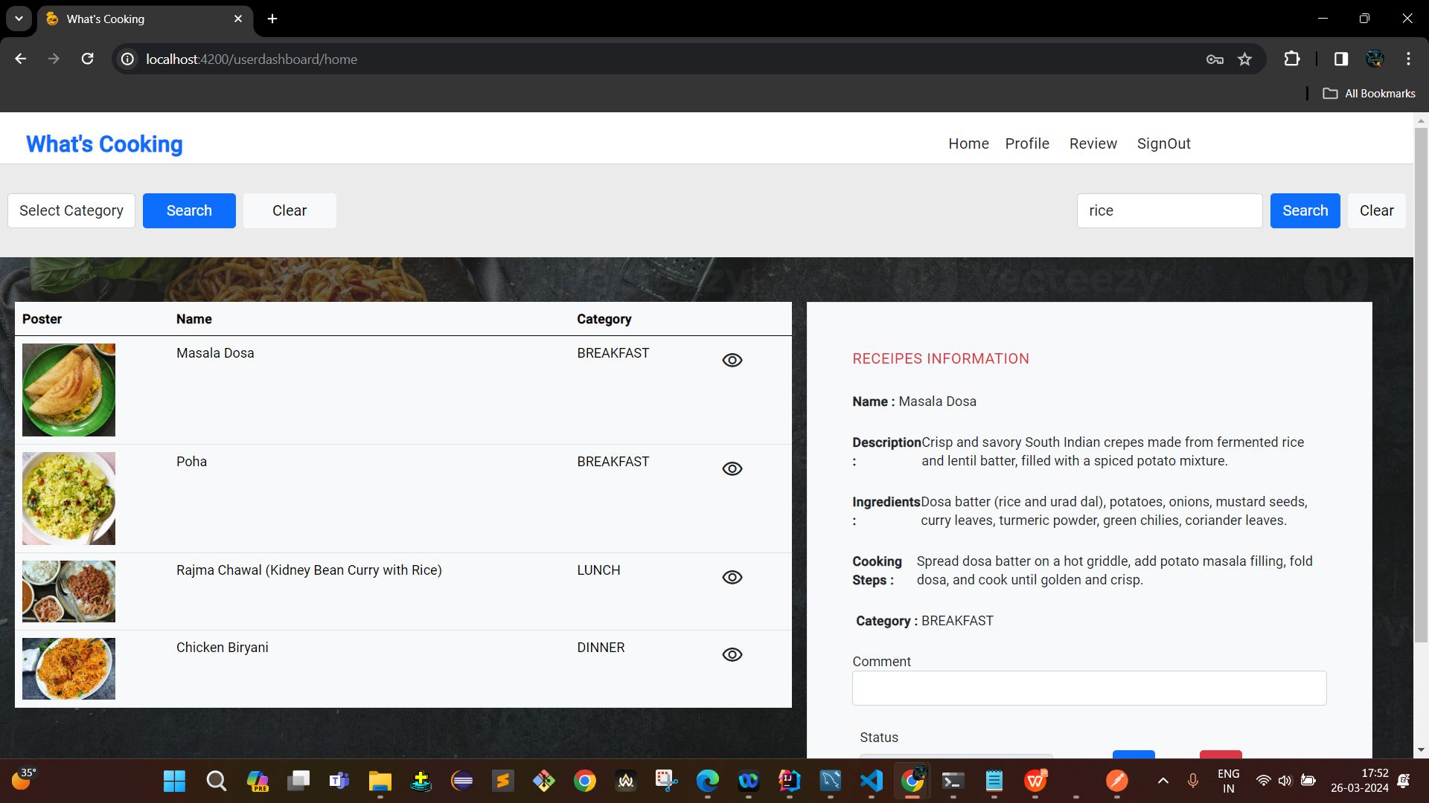
8. OUTPUTS: User page: Dashboard: Search by keyword

Slide 26
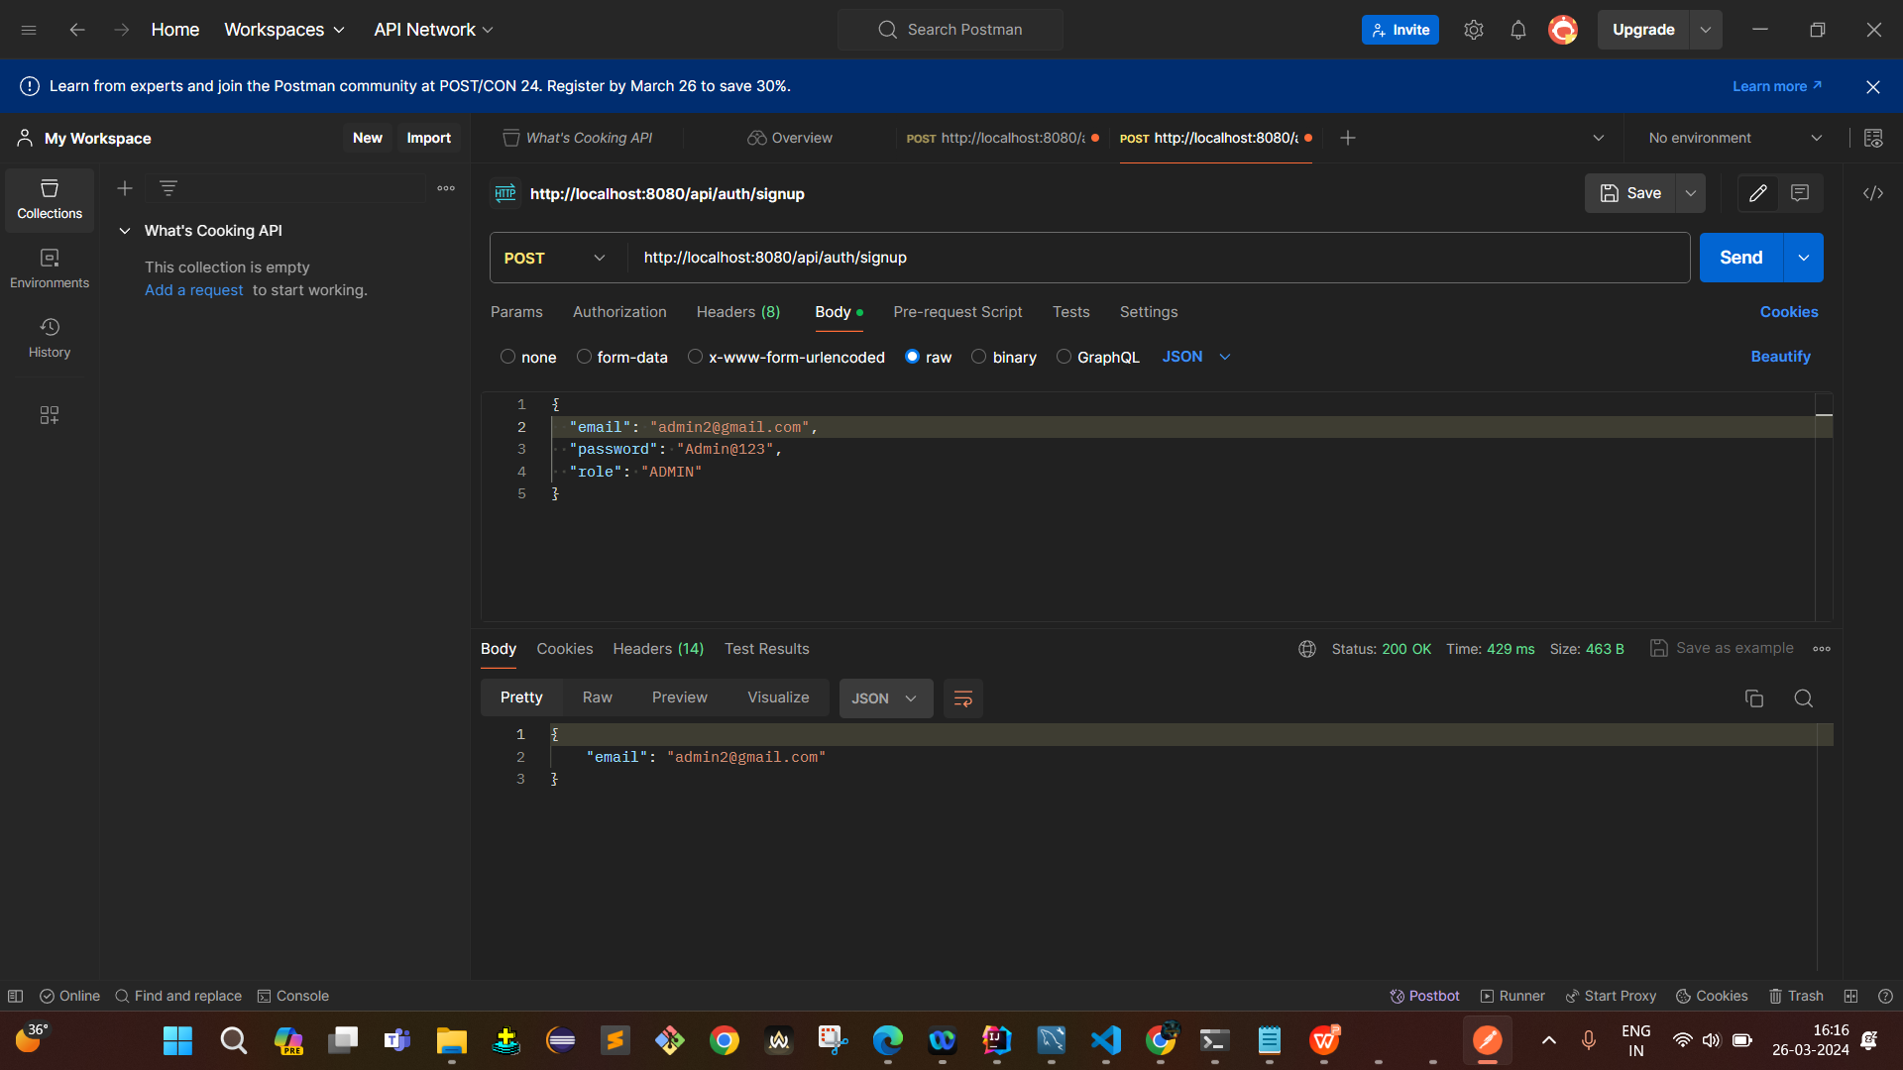
8. OUTPUTS: Postman Testing: Signup

Slide 27
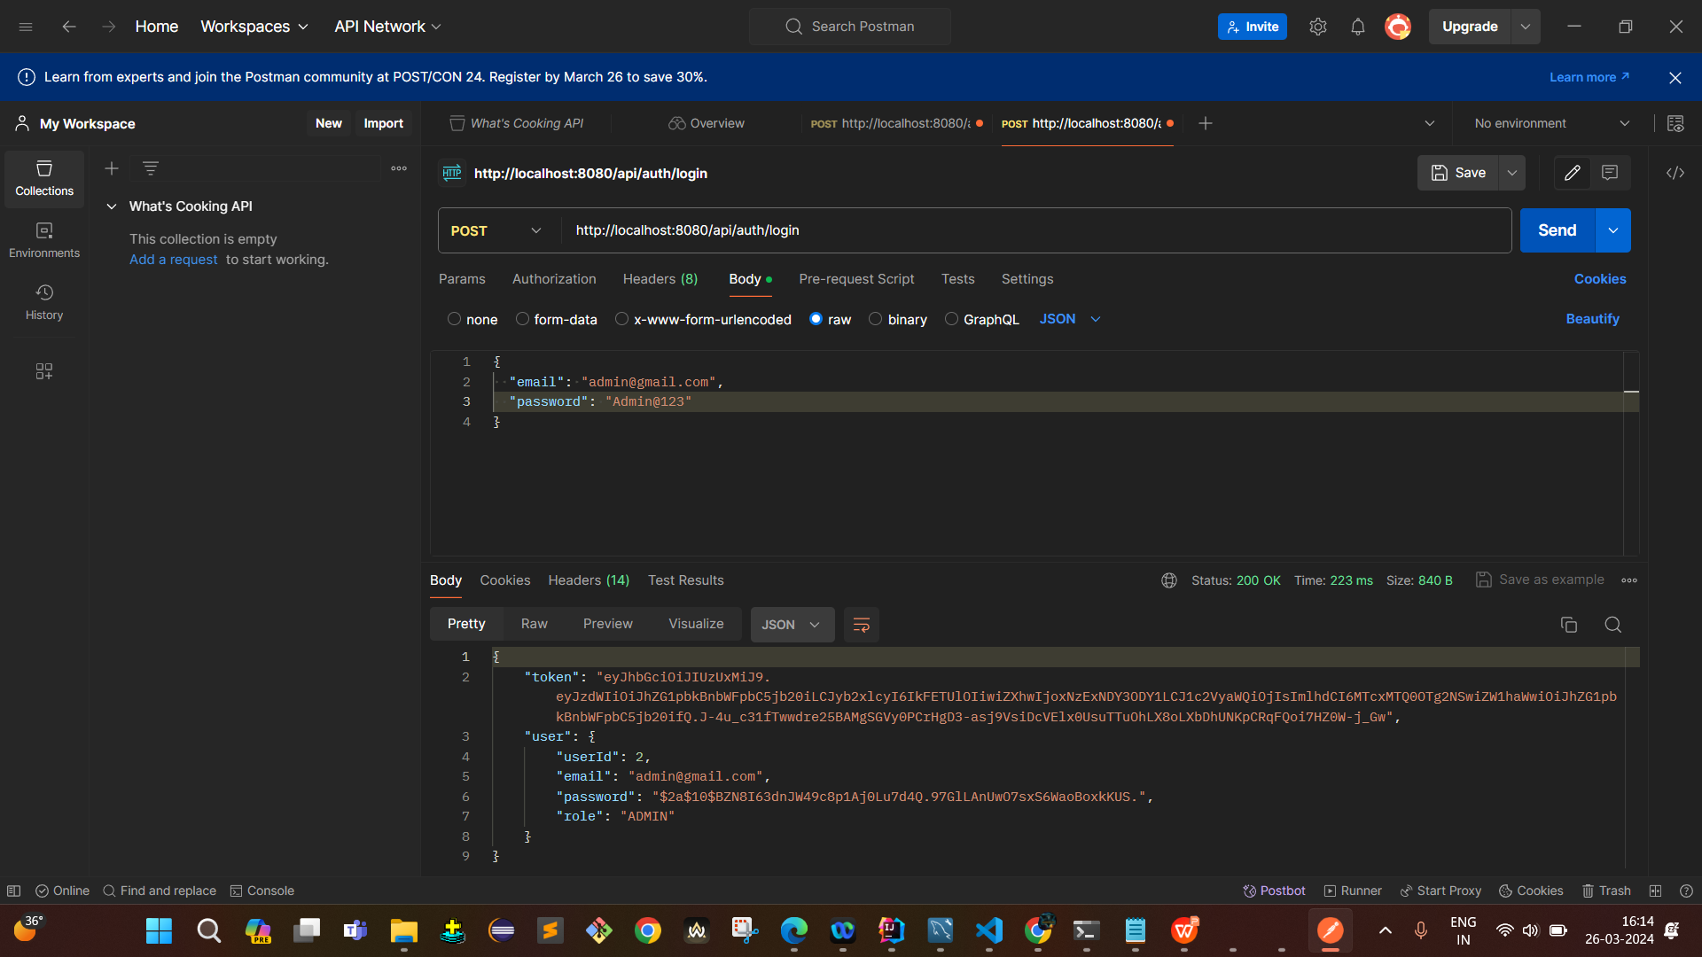
8. OUTPUTS: Postman Testing: Login

Slide 28
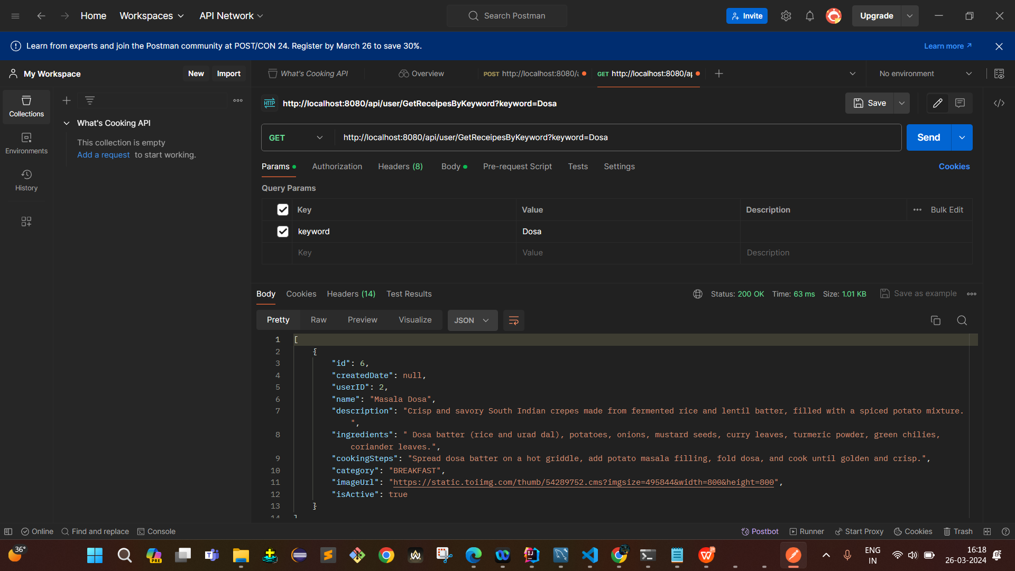
8. OUTPUTS: Postman Testing: Search by keyword

Slide 29
FUTURE WORK
* Add more user interface feature. * Promotional offer * Commercialize the web app

Slide 30
CONCLUSION
The main objective of the application is to understand the concept and implementation of Java, Spring Boot, Databases and Angular technology.
Our project helps the users to easily find out their choice of taste and recipe.

Slide 31
Thank you!

